Slide 1
Section 3.6 Derivatives of Logarithmic Functions

Slide 2
We have learned many techniques to find derivatives for functions, and here is the last one. After this, we are going to look at various applications of differentiation.
There are two important formulas you have to memorize:
The second one is actually a special case of the 1st one when we replace “a” by “e”.

Slide 3
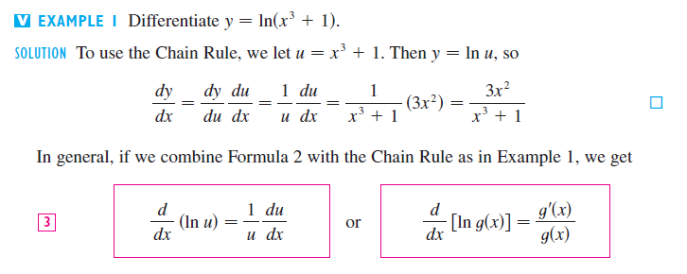

Slide 6
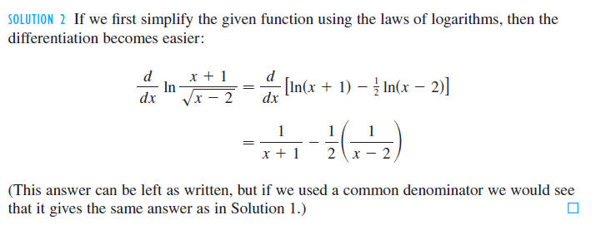
Even though we can differentiate the logarithm right away, but I prefer the following more clever approach.

Slide 7
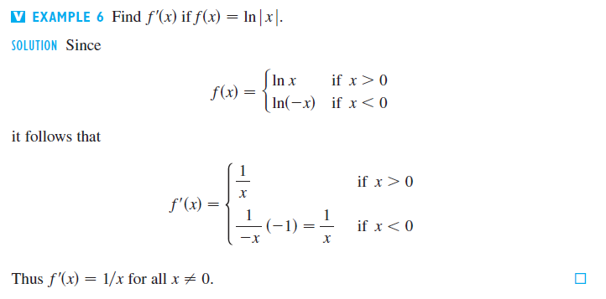
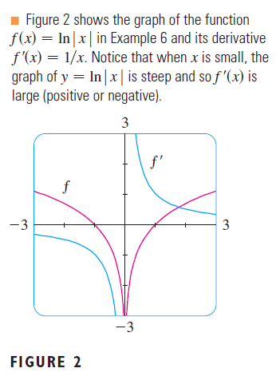
Slope is negative on this side
Slope is positive on this side

Slide 8
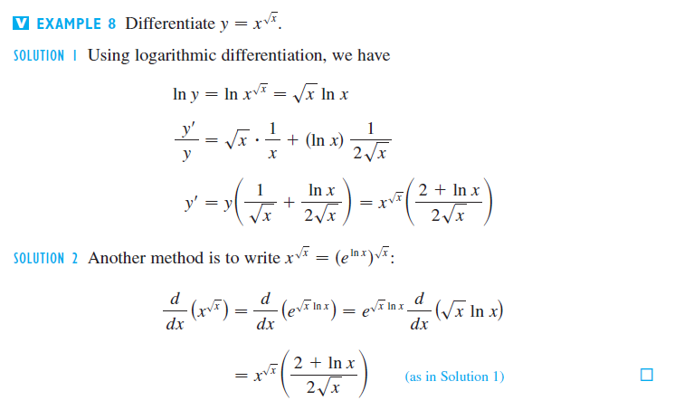
Using logarithms, we can differentiate some complicated functions such as the one below.

Slide 10
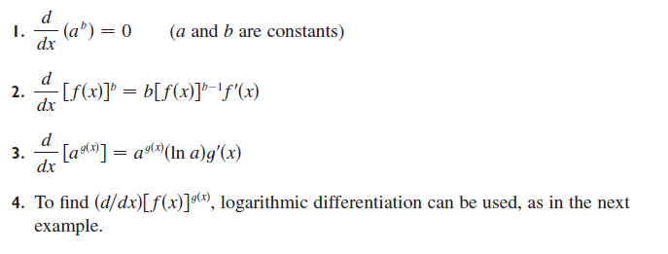

Slide 12
